Slide 1
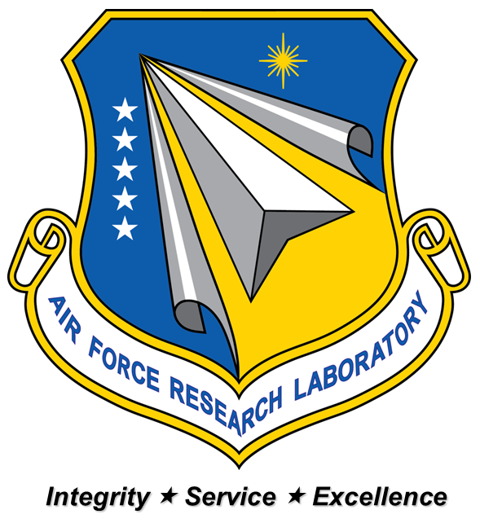
Modeling CMC Microstructures Using Segmented Fiber Data
Collin Blake
Contractor
AFRL/RXCC
Air Force Research Laboratory

Slide 2
Motivation
Desire to better understand microstructure and its effects on material properties at macro scale
Quantify structure properties that induce and drive damage within microstructures
Create a database of reoccurring micro structures with high damage probabilities
Difficulties
Combining coatings and separation of clusters in BSAM
Accurate and robust surface selection algorithm
Proper mesh seeding/size
Optimization with respect to time

Slide 3
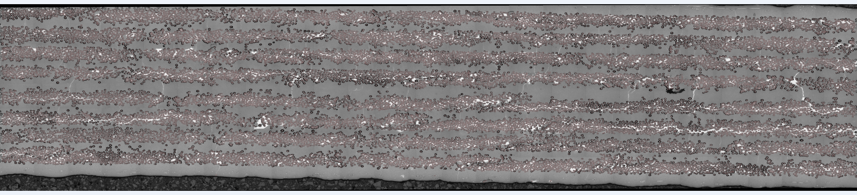
Background
Matlab script that gives geometric fiber data (i.E. X- and y-coordinates, major and minor axis, angle of rotation, etc.) From fiber-matrix scan
Need to produce a model that can be executed using BSAM

Slide 4
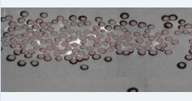
Segmentation and Division
Analyze one layer at a time, using Matlab script to identify and describe fibers
Data is then divided into sub-sections using a separate Matlab script file

Slide 5
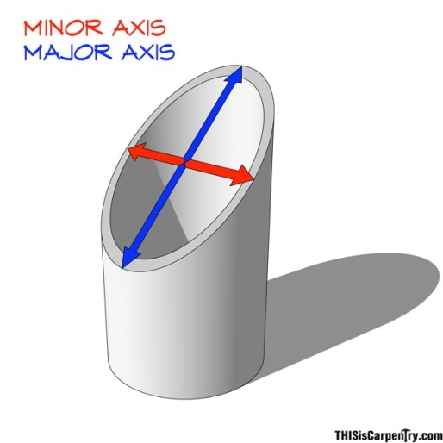
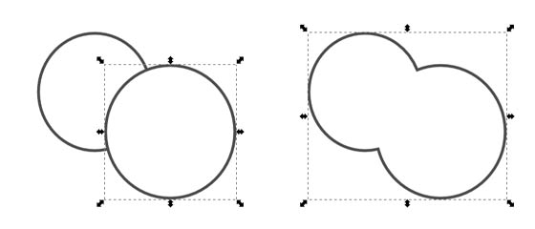
Modeling
Start with coordinates and radius of each fiber (idealized model)
Data given in elliptical format, for now we assume idealized circles
Assumption is due to image given has angled fiber orientation, therefore radius should be minor axis of fibers given
Using Abaqus with a Python script file, coatings are added and combined
Difficulties arise for combining coatings
Discussion in next slide

Slide 6
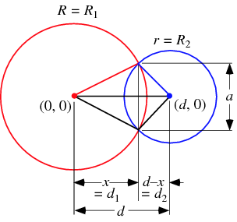
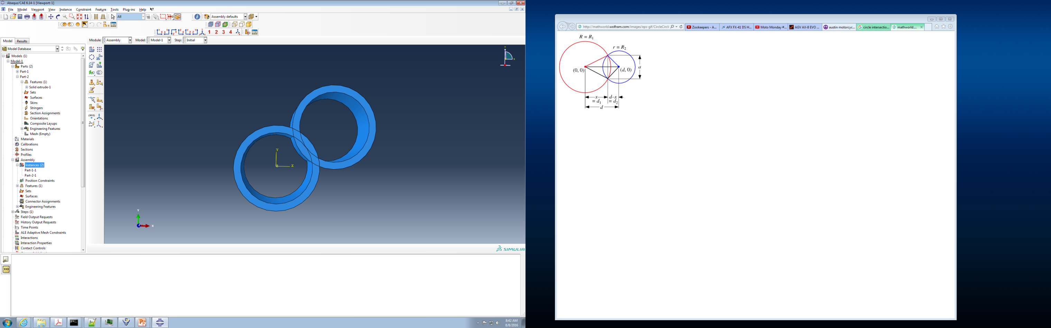

Combining Coatings
Single cluster for all coatings
Combine geometries at sketch level
Using circle intersection formula to find intersection points and create arcs
Single cluster per coating
Combine geometries at the part level
Simple Boolean command in Abaqus with renaming of part instance

Slide 7
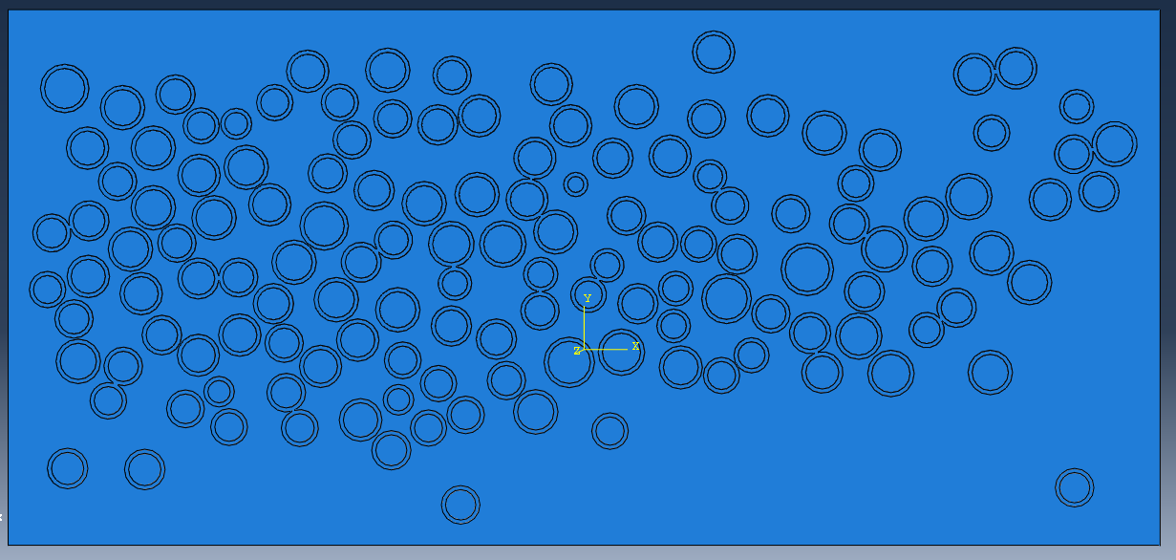
Modeling (cont’d)
An assembly is created to mesh
Matrix template is created and is then cut by fiber and coatings
Assembly is then created by inserting part instances into the assembly for meshing
Complex geometries require mesh refinement around intersections

Slide 8
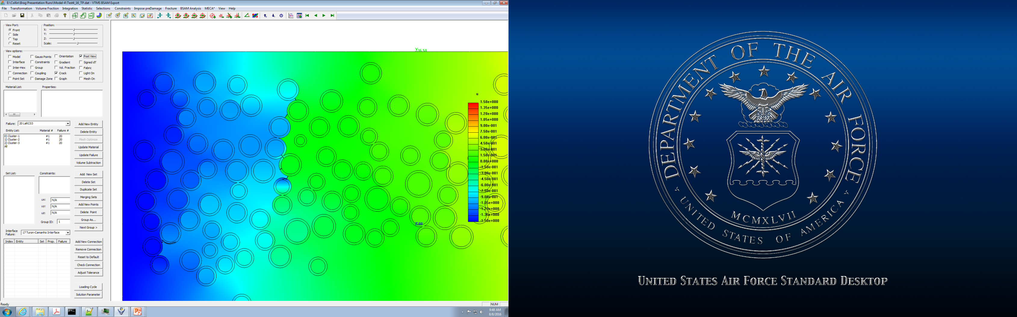
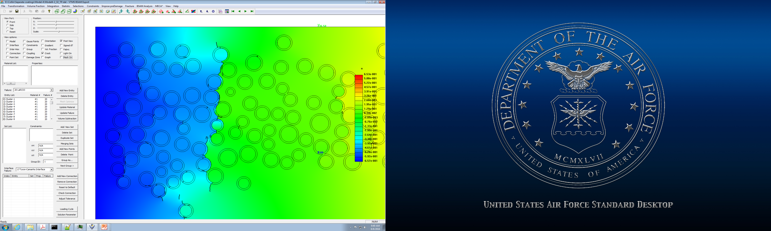
Modeling
Start with coordinates and radius of each fiber (idealized model)
Assume radius is the minor axis, eccentricity to be added later
Fibers are not allowed to overlap
Using Abaqus with a Python script file, coatings are added and combined
Coatings as a single cluster leads to suppression of crack insertion
Later changed to separate clusters for crack initiation
An assembly is created to mesh
Refinement of seed to ensure matrix meshing and mesh compatibility
Single cluster for all coatings
Individual cluster for each coating

Slide 9
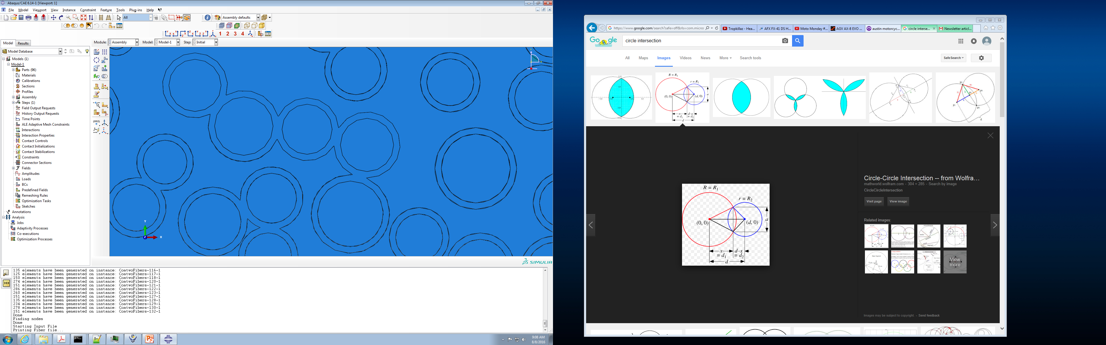
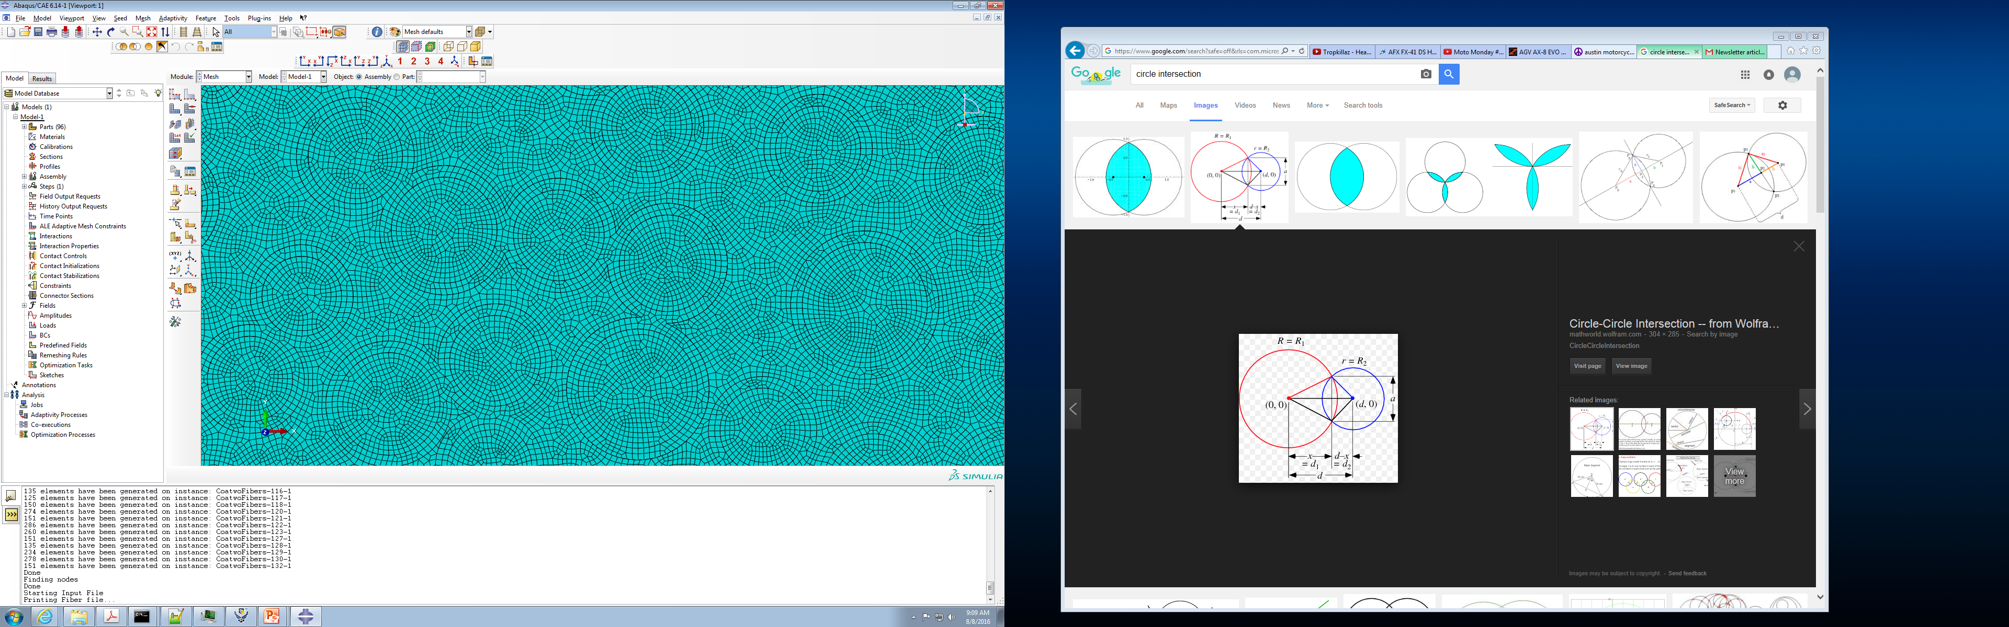
Meshing Geometries
Complex geometries require mesh refinement around intersections
Sharp points are created from intersection of coatings
High refinement needed in this area to mesh without error
Will look for better refinement options in the future

Slide 10
Surface Selection
In order to use BSAM connection properties for interfaces, connecting surfaces must be found
Use bounding cylinder around coating node to select nodes in matrix that correlate to nodes on each coating
Take found nodes and determine connecting elements
Save found elements for connection element sets in BSAM

Slide 11
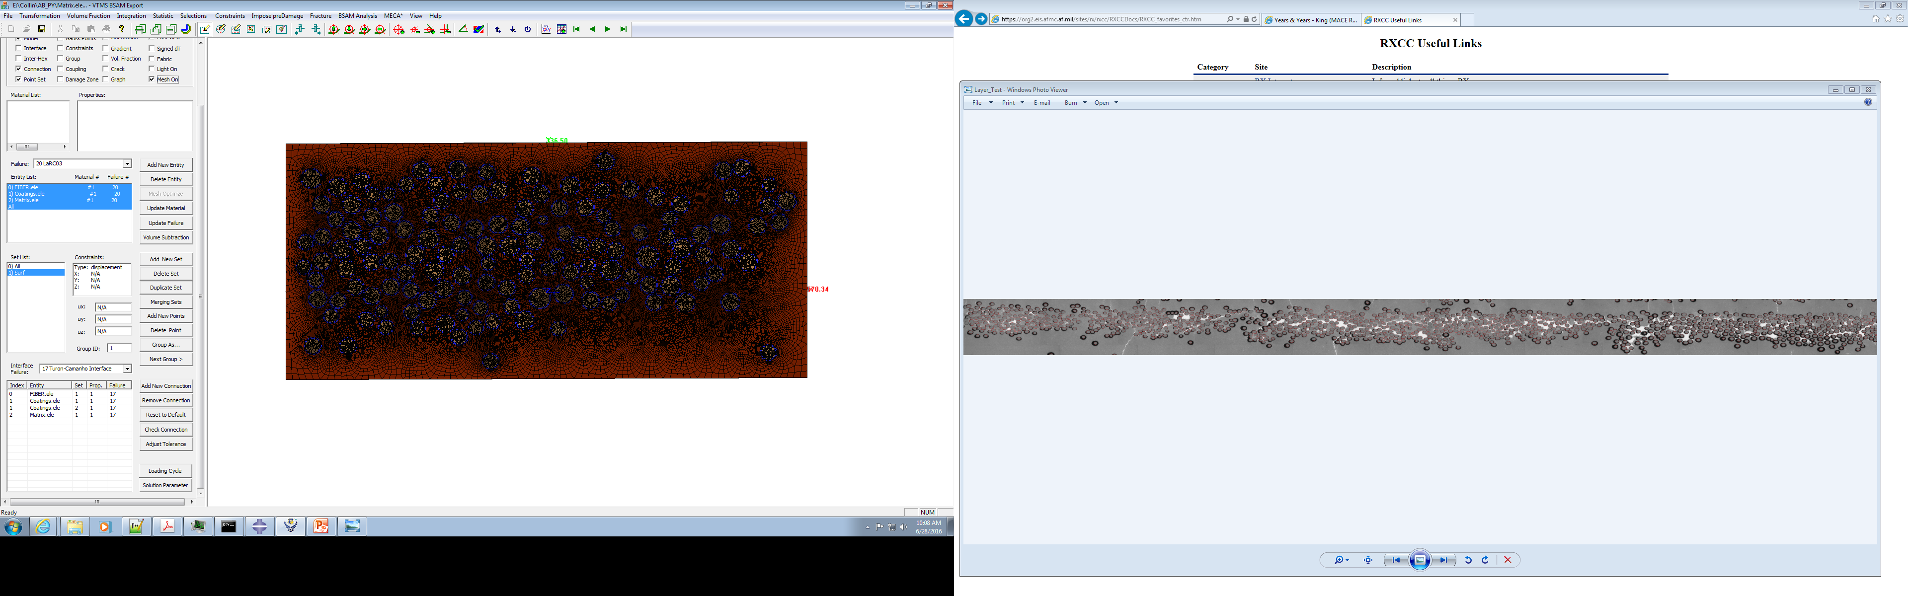
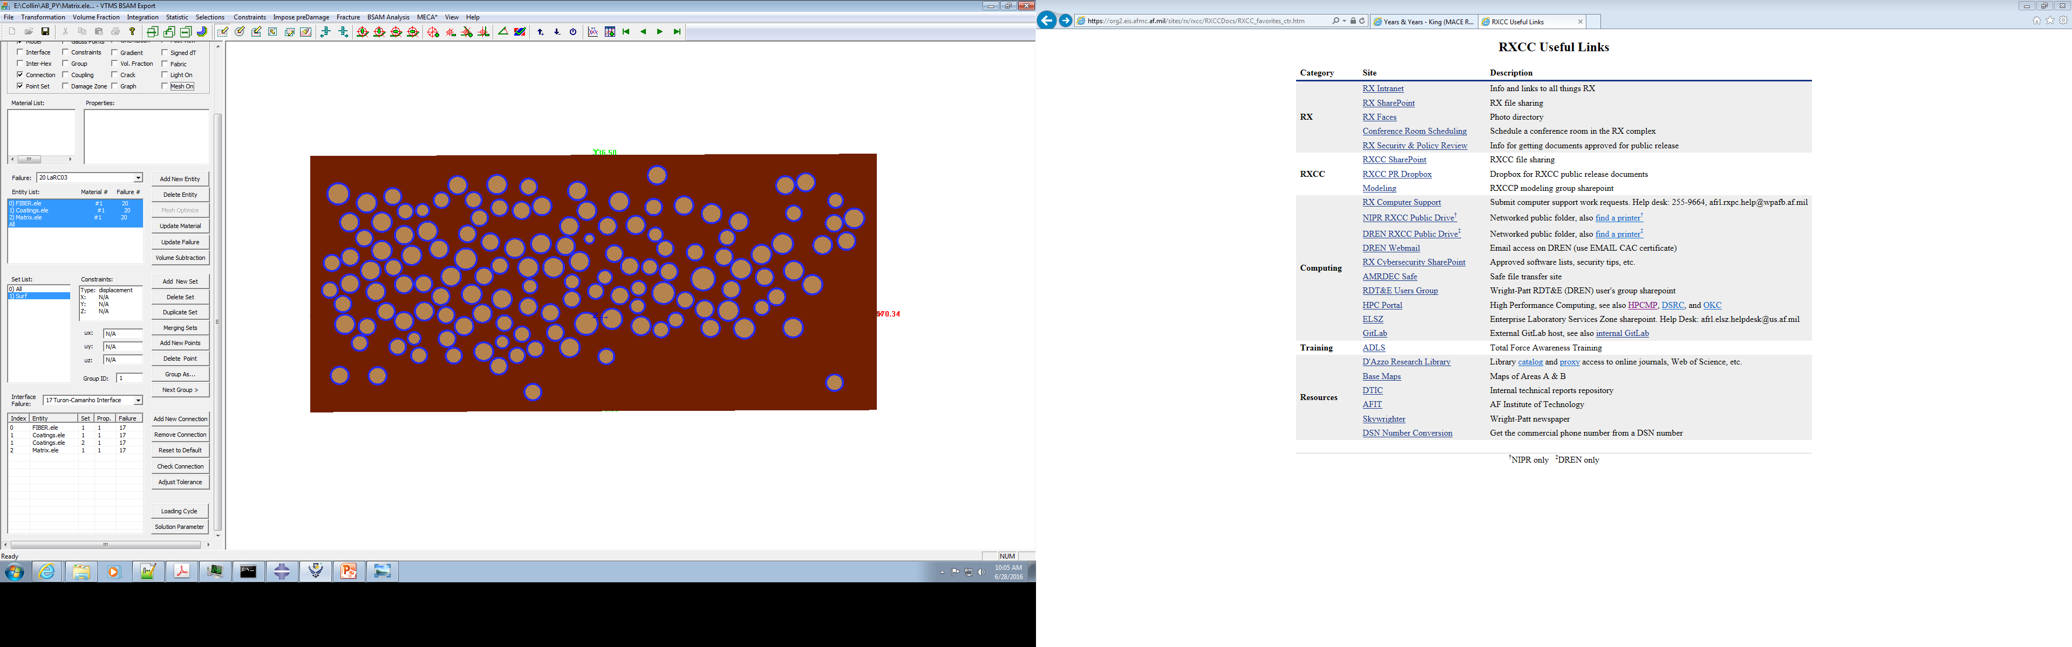
Modeling (cont’d)
Resulting mesh is saved in Abaqus
In order to use BSAM connection properties for interfaces, connecting surfaces must be found
Surface selection is much more difficult for individual coatings

Slide 12
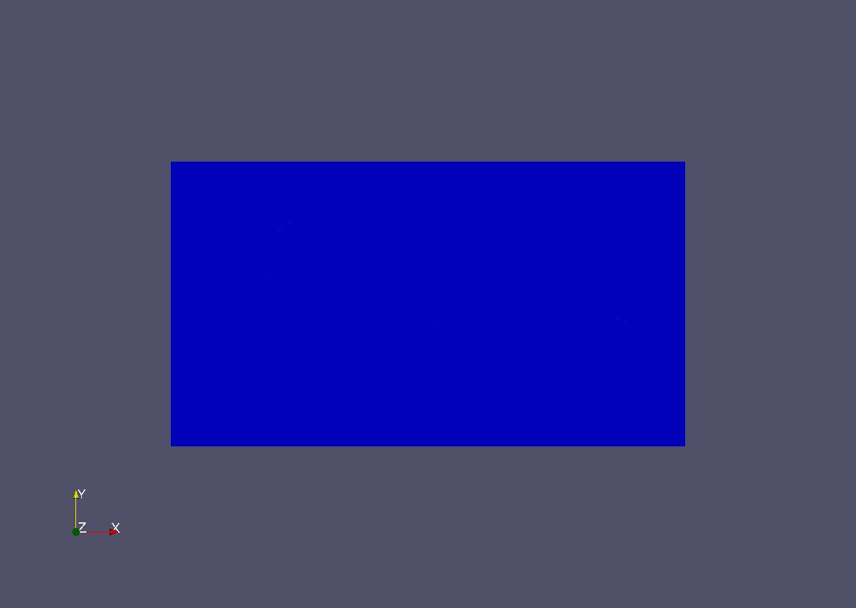
Input and Analysis
Once connections are established, an input file is created and then run using BSAM
File includes output for loading along boundary conditions for load-displacement curves
Allows for Mesh Independent cracking along with separation between interfaces
Looking for modes of damage propagation

Slide 13
Currently
Reworking selection algorithms for efficiency and speed
Implementation of advanced searching algorithms and rewrite of output portion of script
Modifying surface selection for robustness
Additional consideration for fiber connection orientations and patterns
Finalizing modifiable parameters and callable arguments
Includes thickness, separation factor for fibers, and mesh seed value

Slide 14
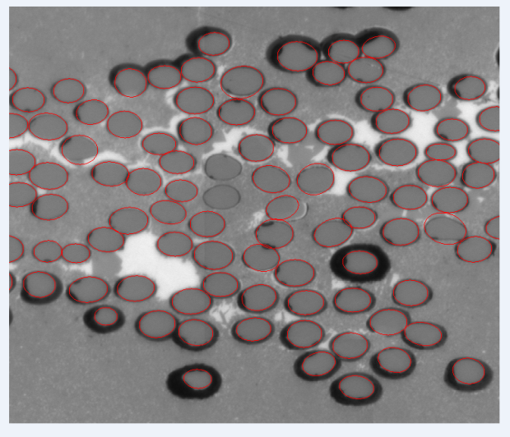
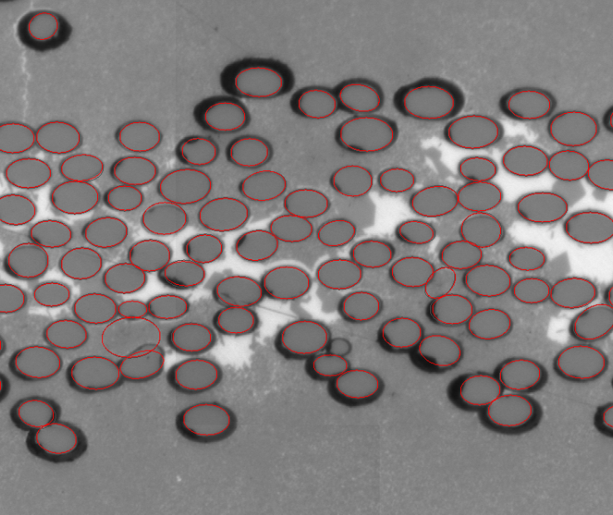
Future Tasks
Further improve fiber identification method and speed of model creation further
Collect numerical data from simulations and being quantitative characterization
Add ability to have eccentricities in coatings, fiber shape, and possible void insertion
Create macro to fully compile models for all sub-sections in a given picture larger than one layer

Slide 15
Questions?

